Slide 1







The Sherwood Pilot
Nazeya Hussain
Head of Customers, Policy and Partnerships

Slide 2
Format
Developing a Neighbourhood Community Budget in a two tier area
Involving residents in redesigning services
Building the case for how to reduce costs and improve outcomes

Slide 3
Delivering in a Two-Tier Context
Kent – largest County in the Country
Kent's population (excluding Medway) is currently estimated to be 1,466,500 people
The annual public expenditure in Kent is £8.25 billion. It also holds over £5 billion of capital assets’.
Police /Health/Probation and Local Authority boundaries are not all coterminous
Population is diverse with some of the most affluent and most deprived areas in the Country
Notes:
Large organisations who have to provide universal and tailored support across a signigficant geography
I needed to them to think and act at a local neighbourhood level – this has been a huge challenges but one which we are succedding at

Slide 4
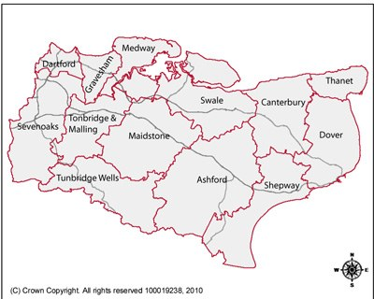

Slide 5
Structures in Transition
Clinical Commissioning Groups across the County and HWB Board
Police and Crime Commissioner
Probation – PbR drive
Voluntary Sector- repositioning and capacity
RSL’s – impact of welfare reform
JCP – Move to Universal Credits
Notes:
Like everyone else, we are facing a significant change in structures across all sectors

Slide 6
Other Significant Programmes
Troubled Families
Integration of Youth Service
Early Intervention Services Review

Slide 7
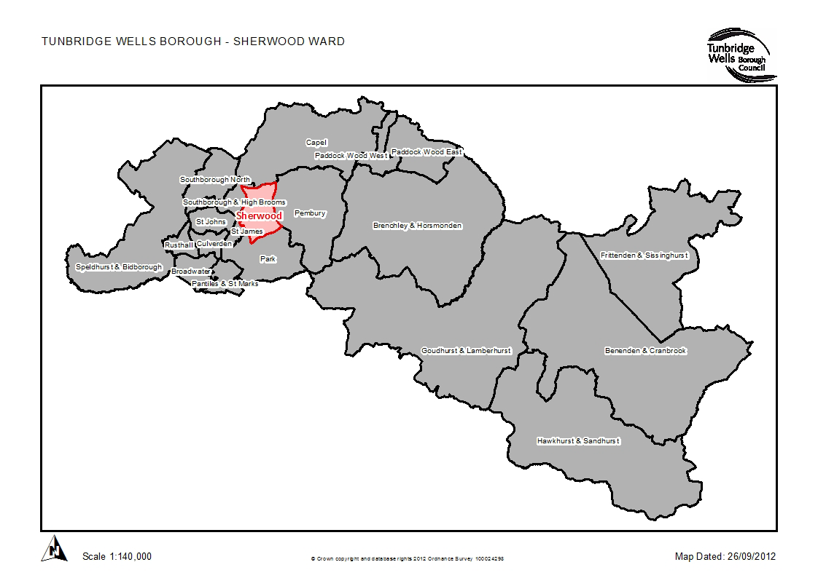
The location of Sherwood
Notes:
You will have pre conceptions of Twells about being affleunt, educated and beautiful,. Its true in the main, but however sherwood faces some significant challenges: Population 6,850, with approx 2,700 households.
Key stats:
Highest concerntation of social housing in the borough, with 77% of social housing tenants in recepit of housing benefit
Higest proportion of lone parents in the borough
800 people of working age on some form of benefit
One LSOA fetures among 20% most income deprived nationallu
One LSOA among 20% most income deprived affecting children nationally and Kent
High levels of rerded crime
Highest levels of alcholo and drug addmissions to hospital
Hihgest rates of obesity in the borough

Slide 8
Our Local Context
Strong Leadership from Public Service Board
£34m regeneration scheme underway
Experience of working jointly in Sherwood for over 10 years
Established community assets and engagement
We were committed to accelerating change in our community AND making it sustainable
Notes:
On the positive side, we have:
PSB – Cexec level of 7 years

Slide 9
Residents Led Approach
As Is’ – Establishing what happens now by using social ethonographers
Understanding the end user experience and using that as the core to our service redesign
Not allowing our organisational and professional judgement to direct the pilot
Notes:
We could have easily tried to come up with a new approach, but this would not have been genuine, we wanted to get on the ground, because something in our approah was not right despite working hard in the nieighbourhood

Slide 10
Key messages from the insight work
Visible minority and an invisible majority
Public agencies are not helping:
  Focus on part of the family, not the whole
  Insufficient coordination e.g. a number of programmes to support people into work
  Intervene too late, when there is a crisis and therefore more costly and less likely to succeed
  Multiple assessments and action plans
  Scope for perverse incentives

Slide 11
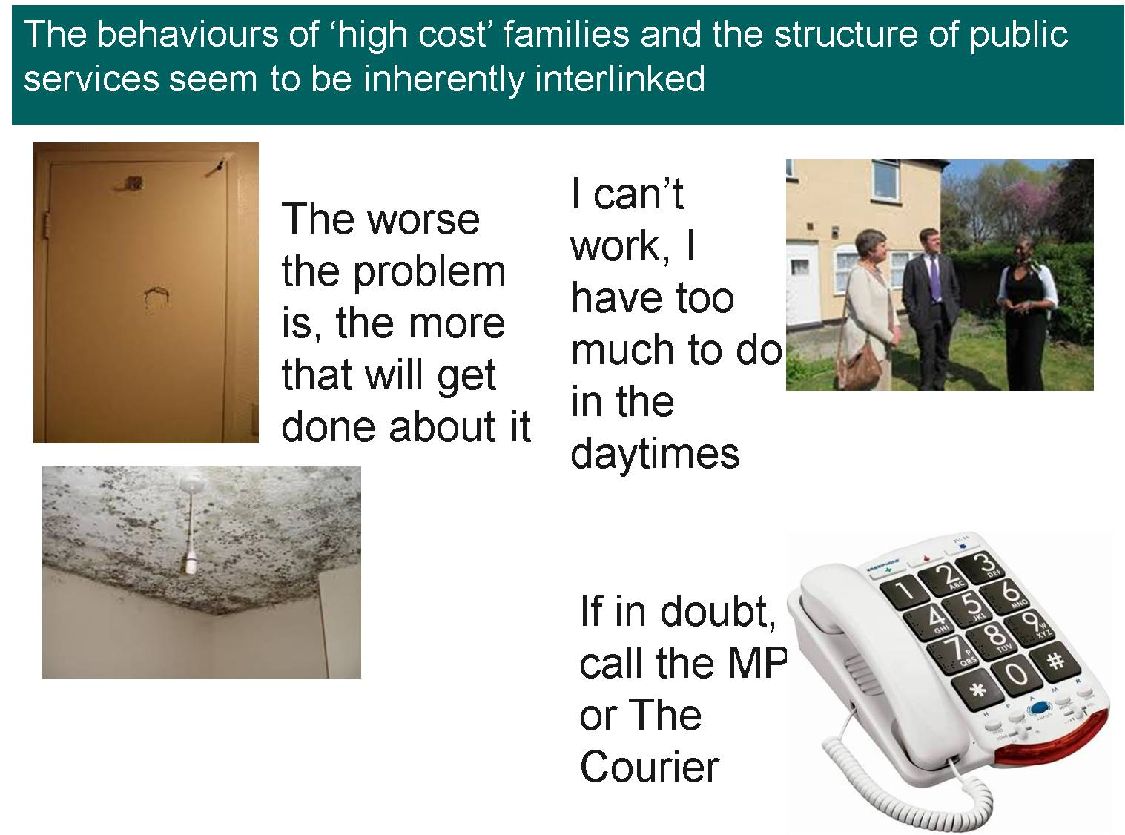
Perverse incentives

Slide 12
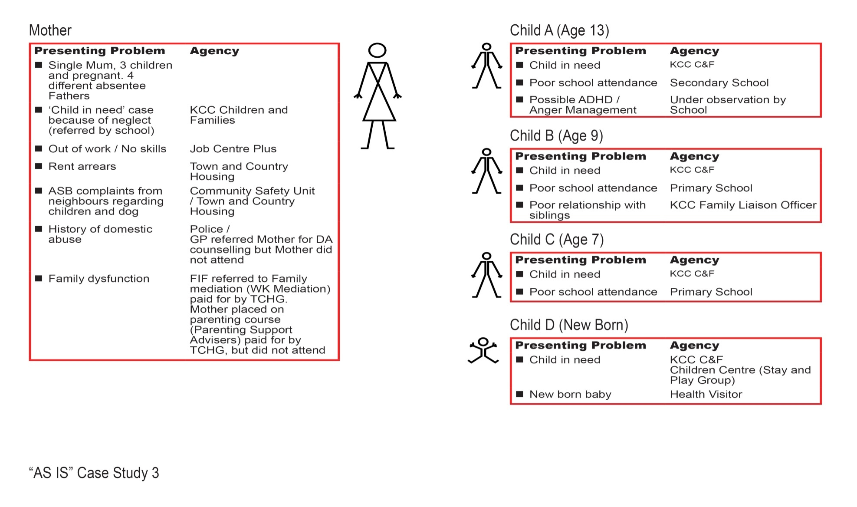
A case study

Slide 13
Building the Case for Change

Slide 14
Resource Mapping
Four biggest budget holders:
Kent County Council £9.55m
Tunbridge Wells Borough Council £7.8m
National Health Service £5.32m (NB. PCT and Community Health Trust costs still to be added)
Job Centre Plus £5.7m
A total of over £13m spent on out of work benefits (including housing benefit and Council tax benefit).? Tax. This could be a source of cashable savings BUT how would these be re-invested back
Notes:
Significant work to undertstand current cost of support and interventions.£35 m annually and we simply cannot sustain this across a population of under 7,000

Slide 15
Costs and Benefits
Big Ticket Issues:
No of children on Child Protection register due to safeguarding issues
No of ASB incidents
% of WAP on ESA due to underlying mental health conditions
% of WAP on JSA
% of 16-18 yrs NEETS
No of evictions
Hospital admissions relating to drug abuse
Notes:
We have spent time examining our approach in terms of developing our CBA approach and we have worked across all our partners to identufy the BIG ticket items, where we know the LARGEST expenditure is taking place, as well as IDENTIFYING MULTI AGENCY deliiverable. We know we can undertaken BASELINE AND PROJECT LONG TERM SAVINGS based on these.

Slide 16
Non Financial Benefits
Sustainable improvements that will address the stubborn and inter-generational societal challenges
Enhanced family resilience
Improved economic engagement
Stronger, safer and healthier communities
Improved quality of life
Happier citizens that fulfil their aspirations
Notes:
At the same time, we are VERY clear from the outset that this is about LONG TERM SUSTAINABLE IMPROVEMENTS

Slide 17
Evaluation
Simple evaluation model that combines the two drivers into a single score:
  Prediction of life outcomes
  Cost of existing interventions
University of Canterbury Christ Church to undertake 2 year longitudinal study
Notes:
SIMPLE model

Slide 18
Making it Happen
Detailed discussions with partners about current spend and outcomes
Challenging current commissioning
Front line multi –agency redesign team
Securing buy in from local stakeholders –GPs and voluntary sector to act as a bridge and referral point
Strong Governance

Slide 19

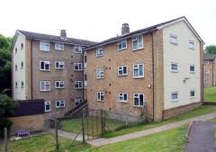


Identify, Assess & Respond to Need
CO-LOCATION
GRIP
Cultural Change
Community Links
Strong, effective, integrated teams
Maximising resources, reducing duplication
Resilience, Aspiration, Sustainability

Slide 20
Supporting the New Service
One performance framework
Workforce development programme
Independent scrutiny of the new service
Joint commitment from all partners about resources and openness about learning from this work
Member buy in at all levels

Slide 21
Challenges Ahead
Facilitate ways for cashable savings from one agency to be reinvested in services that prevent crises
Pooling budgets and letting the community take on even control
DCLG recognising this is just the start and not the end

Slide 22
Summary
Be challenging of ‘As Is’
Build strong partnership links with champions across agencies
Be robust in your evidence
Be bold in your ‘To Be’ design
Evaluate and continue to build the case
Don’t take NO for an answer!

Slide 23
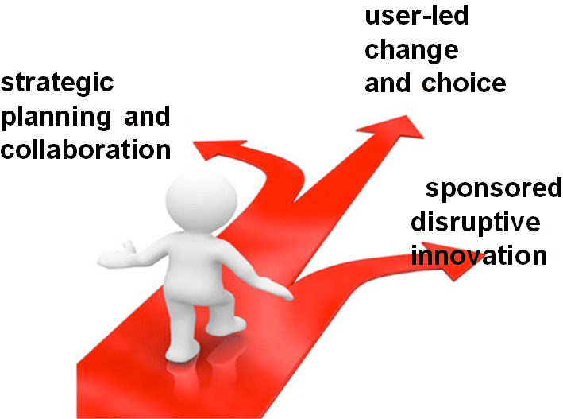
The Road Ahead

