Slide 1


DEVOLUTION
REVOLUTION
THE NEXT STEPS TO
DELIVER OUTCOMES
#FUTUREDEVO
Notes:
Hello everyone, thank you for coming today!
And, thank you to PWC for all their support and hosting us here today!

Slide 2


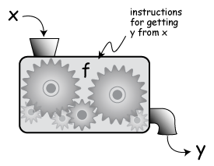

#FUTUREDEVO
Notes:
Decided to do this because we are at a critical point in the devolution story.
While nearly 12 devolution deals have been made, questions over how these new powers will be used – and to what ends, still need to be answered.
We thought it was timely to reflect on how devolution conversations can make the move from thinking about FORM to FUNCTION.
We’ve been focusing too much on how we want it to work, rather than what we want it to DO.
So, we designed a game to understand what would happen if the devolution question can began with ambitions for place, rather than permissions from the treasury.

Slide 3
Notes:
So as I mentioned, we designed a game.
We decided to locate this in the fictional city region of Chamberlainville, which as you can see is the only perfectly spherical combined authority in the UK!
To make things interesting, we gave each of the players responsibility for looking after one of Chamberlainville’s six boroughs.
We set these teams against each other in a race to secure their next devolution deal for the city region.
But to do this, they had to compete with a central team of central government experts
When looking at the city region as a whole, the teams were able to think of some great high level priorities.
However, when given their specific borough identities, they became territorial, and the wider vision for the place was lost. This reflects a clear problem in practice.

Slide 4



DEVOLUTIONARY PRIORITIES
Infrastructure for future economies
Improved wellbeing and inclusion
Internationally competitive labour market
#FUTUREDEVO
Notes:
First challenge was for places to set priorities for the city region over the next five years, in line with the Mayor’s ambition for more inclusive growth.
For both teams, the priorities for Chamberlainville fit broadly into three categories.
Putting in place the physical infrastructure for future economies
DIGITAL ENTERPRISE ZONE: Free wifi available across the city to boost the digital enterprise sector, particularly via a Public Service Innovation Catapult. Supported by business rate discounts to new digital businesses.
Creating an internationally competitive labour market
CITY OF ASPIRATION: A cradle-to-grave education and skills programme to create a more connected, streamlined, Chamberlainville-centred curriculum, tailoring education to local employment opportunities to create the workforce supply needed for industries to compete internationally.
Maximising wellbeing and ensuring that local economies are inclusive
HOUSING GROWTH LANDHOLDING COMPANY: A vehicle to get land to market for the creation of new residential developments
meeting specific local needs. Based on a single Public Land Commission which would cross-subsidise affordable housing
projects with revenues from private sales.
WHEN WORKING OUT HOW TO DELIVER THIS, WE DISCOVERED CHANGE WAS NEEDED IN THREE DIMENSIONS.
- Devolution for Reforming Public Services
- Transformation of the relationship with central government
- Strengthening democracy

Slide 5
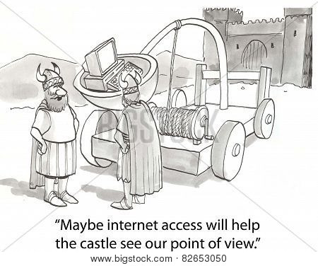
PUBLIC SERVICE REFORM: DEVOLUTIONARY TRENDS
Integration of service reform with economic plans, on demand side and supply side
Will seek more power over education, skills, health and blue light services
Will need to evidence impact of their transformations
#FUTUREDEVO
Notes:
So first then – what will we see in future public service reform?
Two approaches taken – demand focus, and supply focus.
Supply side: PUBLIC SERVICE INNOVATION CATAPULT: Venture capital fund dedicated to supporting growth in one of the cities’ regional strengths: public service. Objective is to develop technologically-savvy public services by capturing local skills and expertise in health and social care, and enable this part of the workforce to become more entrepreneurial, linking to businesses attracted by the Digital Enterprise Zone.
Demand Side: BETTER LIVES PROGRAMME: A public service integration and reform programme which would apply learning from the ‘Troubled Families’ approach to all vulnerable people, to address issues such as mental health, substance misuse, crime, isolation and depression. Based on a gain-share with central government.
But most significantly we found that at the moment, local government do not have the power to shape skills and education in the way they feel they need to deliver growth. This will therefore be a clear area for future devolution.

Slide 6

CENTRAL-LOCAL RELATIONS: DEVOLUTIONARY TRENDS
Relationship needs to change to encourage risk taking
Letting go and mutual respect
Increased transparency
#FUTUREDEVO
Notes:
But this is not the only place they will push for change.
The game suggests that the sector are ready to take on new risks in order to deliver their economic plans. However, central government are not ready to let go. For instance:
One group sought to establish a ‘council company’ to engage with housing markets as competitors, rather than regulators. (housing company, energy company). This proposal was rejected.
To finance their future economy plan, Chamberlainville sought devolution of a levy on the local renewable energy industry, so that they could reinvest this more prudently to grow the sector. This request was rejected.
To incentivise new companies to set up in their digital enterprise zone, Chamberlainville sought greater control over business rates to offer incentives. This request was rejected.
To reward them for the savings they would deliver to centrally controlled budgets (such as welfare payments) one team requested a gain-share model with central government. This request for a greater incentive was rejected.
However, the reasons for these rejections were not always publicised. And the central team thought that the city teams plans lacked ambition!
This contradiction represents a clear need for greater transparency about the terms of devolution, and reflection by central government on how risks can be shared over the longer term.
Future fiscal devo should build resilience in local economies, and help the differences between them to become strengths rather than weaknesses.
This may mean new revenue streams, or greater flexibility to control existing powers

Slide 7
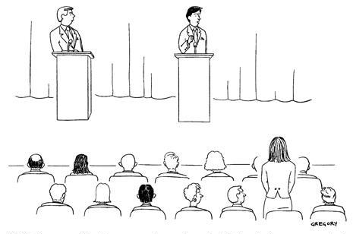
STRENGTHENING DEMOCRACY
Devolution’s new democracy can’t only be about Metro Mayor’s
Local Gov have to empower communities
Transparency
#FUTUREDEVO
Notes:
Lastly, we have learned that devolution’s democratic offer cannot only be about the mayors.
In the game, players often defaulted to the mayor as the arbitrator of accountability. This led to harsh attacks from twitter about the lack of public engagement and closed doors approach of Chamberlainville CA.
If we have learnt anything from the last few weeks and recent referendum, it is that representative democracy is not always seen as democratic enough – especially when there is a lack of transparency about how decisions are being made.
Local government must work with other place-based partners to create the infrastructure which enhances citizen control over outcomes, develops civic consciousness, and generates buy in to future devolution.

Slide 8
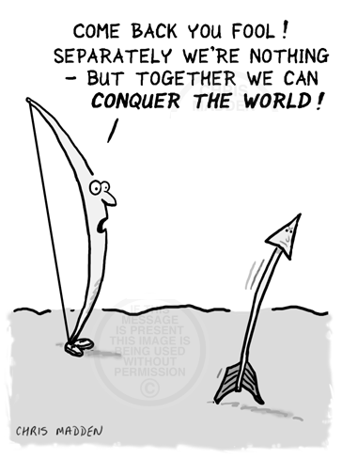
RECOMMENDATIONS
‘us and them’ mentality must end
combined authorities must work together to integrate effectively
central government must create the conditions for risk if they want innovation
democratic offer cannot just be about the mayors
#FUTUREDEVO
Notes:
Us and them.
1. The tiers-based bias of ‘think’ capability in central government, and ‘do’ capability in local government must change. A more flexible workforce is needed.
2. Combined authorities must work together. Incentives for collaborative behaviour are required throughout all scales of the workforce. Creating positions for ‘systems translators’ who can talk across silo’s is one first step.
3. Central government must be prepared to create the conditions for local government to take risks, and develop distinct economic offers. Greater control over locally spent revenue streams and full control over business rates will be a big part of this.
4. The democratic offer of devolution will have to be about more than the mayors. While they can inspire excitement about devolution, processes of participation should go much further and develop community leaders with deeper civic consciousness.

Slide 9
#FUTUREDEVO
Notes:
Thank you very much, I look forward to the discussion.

